Slide 1






WHAT ARE INTEGERS?
by C. Vidhya
INSPIRED BY

Slide 2







DEFINITION OF INTEGERS
Integers consist of all positive whole numbers, negative whole numbers and zero.
-3, -5, 0, 1, 7, and 18 are integers.
1.6, ½, 5%, and -2.43 are not integers.

Slide 3





DEFINITION OF INTEGERS
Integers consist of all positive whole numbers, negative whole numbers
and zero.
-3, -5, 0, 1, 7, and 18 are integers.
Negative integers:
-3, -5
0 is neither positive or negative.
Positive integers:
1, 7, 18

Slide 4
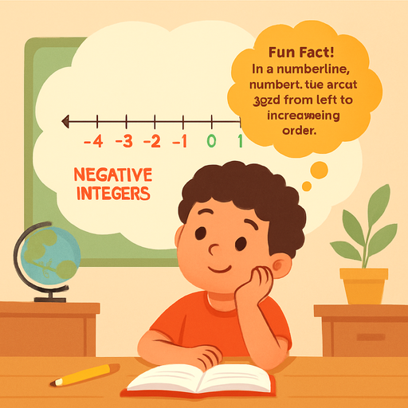


INTEGERS ON A NUMBER LINE
We can illustrate integers using a number line.
Zero is neither
positive nor negative.
-4
-3
-2
-1
0
1
2
3
4
5
NEGATIVE INTEGERS
POSITIVE INTEGERS
Negative numbers
are on the left of 0.
Positive numbers
are on the right of 0.

Slide 5




PLOTTING INTEGERS ON A NUMBER LINE
Locate the corresponding point to the left or to the right of 0.
Example: Plot 4 on the number line.
-4
-3
-2
-1
0
1
2
3
4
5
Because 4 is positive, we plot 4 units to the right of 0.

Slide 6
PLOTTING INTEGERS ON A NUMBER LINE
Locate the corresponding point to the left or to the right of 0.
Example: Plot -2 on the number line.
-4
-3
-2
-1
0
1
2
3
4
5
Because -2 is negative, we plot 2 units to the left of 0.

Slide 7

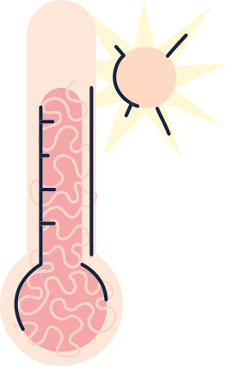



LET’S TRY
Find a pair and recall the
previous question.
From 0 degrees Celsius, the temperature increased by 5 degrees in the morning. In the evening, it decreased by 10 degrees. How can we represent these values using integers?

Slide 8
LET’S REPRESENT
Increase of temperature by 5 degrees
-4
-3
-2
-1
0
1
2
3
4
5
-10
-9
-8
-7
-6
-5
-4
-3
-2
-1
0
1
2
3
4
5
Decrease of temperature by 10 degrees

Slide 9


LET’S RECALL
Answer the following to check your understanding.
1
2
3
What is one application of integers in real-life?
What is an integer?
How do you plot integers?

Slide 10

SAMPLE ANSWER
LET’S RECALL
Answer the following to check your understanding.
1
2
3
What is an integer?
An integer can be a positive whole number, a negative whole number, or zero.
How do you plot integers?
To plot integers, locate the corresponding point to the left or to the right of 0.
What is one application of integers in real life?
One application of integers is the representation of
an increase or decrease
in temperature.

Slide 11
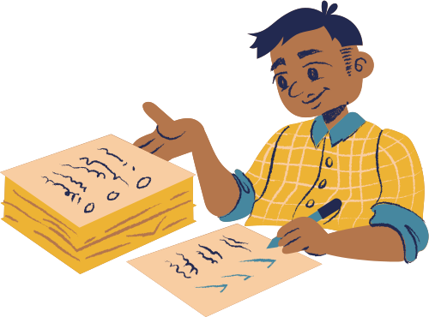

REFERENCES
Mathspace. “3.01 Integers | Year 6 Math |
Australian Curriculum Year 6” Accessed 31 July 2023, https://mathspace.co/textbooks/syllabuses/Syllabus-1166/topics/Topic-22053/subtopics/Subtopic-280655/?searchString=&activeTab=theory
Mathspace. “3.02 Number lines | Year 6 Math |
Australian Curriculum Year 6” Accessed 31 July 2023, https://mathspace.co/textbooks/syllabuses/Syllabus-1166/topics/Topic-22053/subtopics/Subtopic-280656?searchString=&activeTab=theory

